Slide 1
Differential Privacy in HealthCare
Group 3 Madhav Sood(IMT2021009)
Nilay Kamat(IMT2021096)
Shlok Agrawal(IMT2021103)

Slide 2
Dataset Used
Predicting Show-Up/No-Show
This is a Kaggle dataset to implement ML models that can determine whether a patient shows up to their appointment based on attributes such as Age, Gender, Neighbourhood, Hypertension, Diabetes, Alcoholism, etc.

Slide 3
Attributes
PatientId - Directly Identifiable
AppointmentID - Quasi-Identifier
ScheduledDay - Quasi-Identifier
AppointmentDay - Quasi-Identifier
Gender - Quasi-Identifier
Age - Quasi-Identifier
Hypertension - Sensitive
Diabetes - Sensitive
Alcoholism - Sensitive
Handicap - Sensitive
No-show - Label to be predicted

Slide 4
Pre-Processing
No null values are present in the dataset.
Label encoded PatientId, AppointmentID, Gender and No-show.
Split ScheduledDay and AppointmentDay to ScheduledYear, ScheduledMonth and ScheduledDate and AppointmentYear, AppointmentMonth and AppointmentDate respectively.
Dropped 3 columns - ScheduledDay, AppointmentDay, AppointmentID.

Slide 5
Data Anonymization Tool
We used the python library - Diffprivlib for the task.
This is IBM’s differential privacy library, and is used for experimenting with, investigating and developing applications in, differential privacy.
It leverages models and queries from well-known Python libraries like numpy and scikit-learn, commonly employed for data analysis and predictions, and integrates differential privacy into these models.

Slide 6
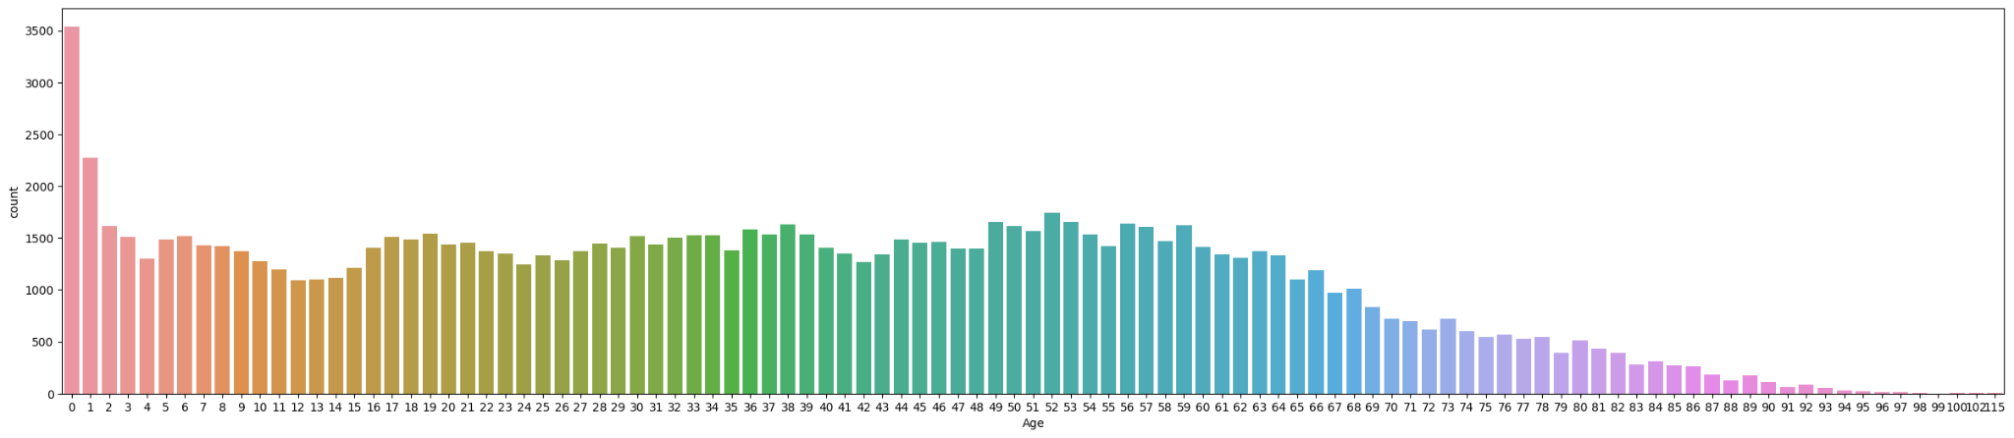
Attribute “Age”
Original distribution of “Age” attribute.

Slide 7
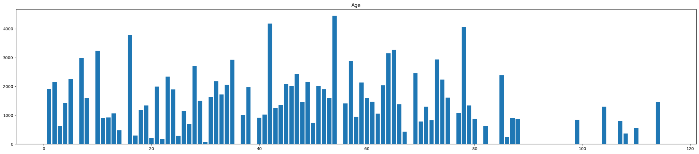
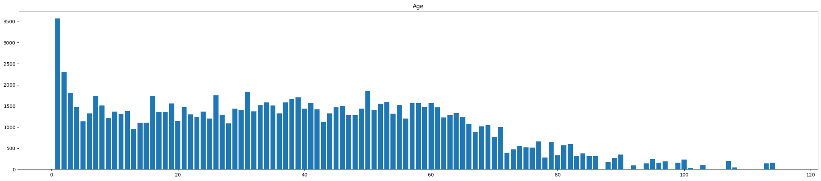
Distribution of “Age” attribute with epsilon = 0.0001
Distribution of “Age” attribute with epsilon = 0.001

Slide 8
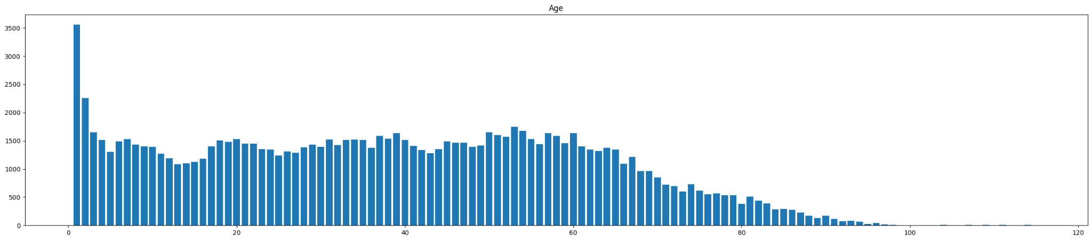

Distribution of “Age” attribute with epsilon =0.1
Distribution of “Age” attribute with epsilon =1

Slide 9
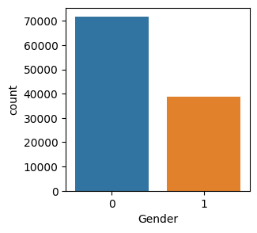
Attribute “Gender”
Original distribution of “Gender” attribute

Slide 10
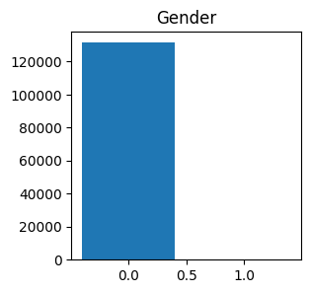
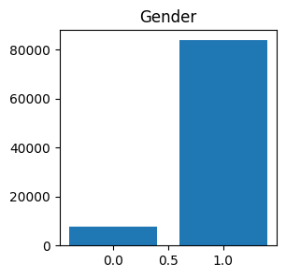
Distribution of “Gender” attribute with epsilon =0.00001

Slide 11
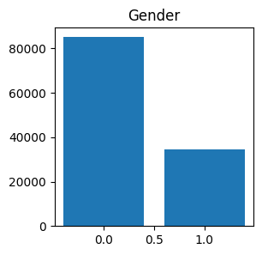
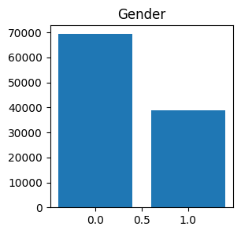
Distribution of “Gender” attribute with epsilon =0.0001
Distribution of “Gender” attribute with epsilon =0.001

Slide 12
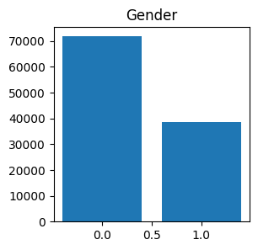

Distribution of “Gender” attribute with epsilon =0.01
Distribution of “Gender” attribute with epsilon =0.1

Slide 13
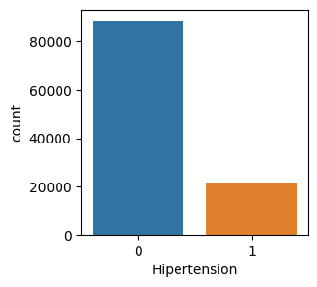
Attribute “Hypertension”
Original distribution of “Hypertension” attribute

Slide 14
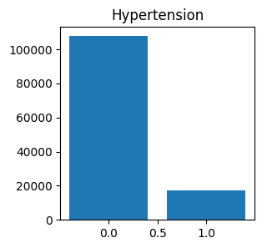
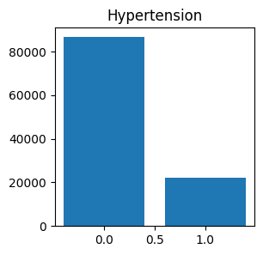
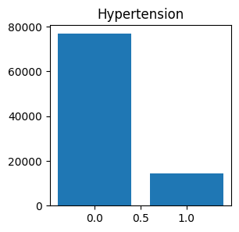
Distribution of “Hypertension” attribute with epsilon =0.0001
Distribution of “Hypertension” attribute with epsilon =0.01
Distribution of “Hypertension” attribute with epsilon =0.001

Slide 15
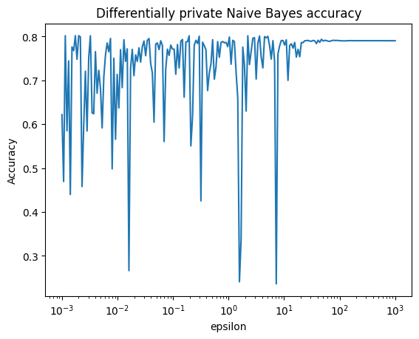
Accuracy values versus Epsilon
The accuracy on the original dataset after preprocessing was 80.11%.

Slide 16
Demo

